Slide 1
A Flexible MIDAS Forecast Model for Gross Domestic Products Growth
Notes:
<number>

Slide 2
Outline
Problem Definition
Benefits of the Project
Solution Approach
Validation of the Model
References

Slide 3
Problem Definition
Gross Domestic Product cannot be forecasted in an effective way in Turkey. Reducing the error margin of the forecast of the gross domestic product has been the focus of the project.

Slide 4

Problem Definition
Converting the high frequency data to low frequency can be performed by means of taking arithmetic average and period end value, but these methods can cause loss of daily information.
MIDAS

Slide 5
Benefits of the Project
Accurate short and medium term forecasts on macroeconomic indicators
Accurate budget estimation
Accurate sharing / dissemination of investment and current
Notes:
<number>

Slide 6
Resources & Tools
Bloomberg terminals in Bilkent University
To provide instant data stream (2002-2017)
R
midasr package
Zoo Package

Slide 7
Data
283 Daily Data
30 Monthly Data
16 Quarterly Data
Notes:
Gaysells, Merkez Bankası ve Kalkınma Bakanlığı temel ekonomik göstergeler
<number>

Slide 8
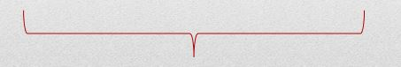
Seasonality and Trend
Monthly and Quarterly
Daily
Decompose Function
Seasonal Decomposition of Time Series (stl Function)
Seasonal Effect
Trendy Effect
Now, check whether time series become stationary or not.

Slide 9
Stationarity Test
Augmented Dickey-Fuller Test
ADF Test: Small p values ( < 0.05 ) suggest the data is stationary and does not need to be differenced stationarity.

Slide 10
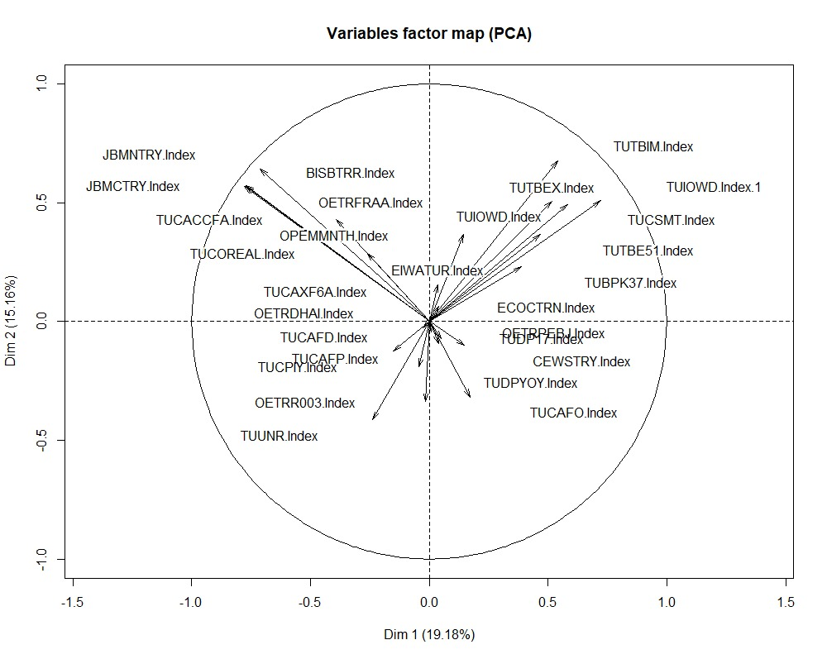
Principle Component Analysis

Slide 11
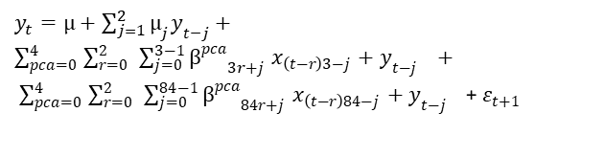
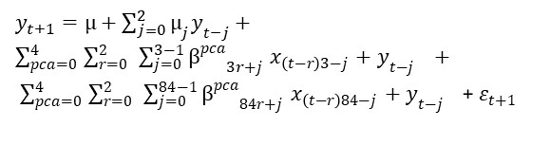
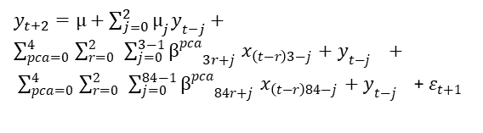
Model
Current Forecast
1 Quarter Ahead
2 Quarters Ahead

Slide 12
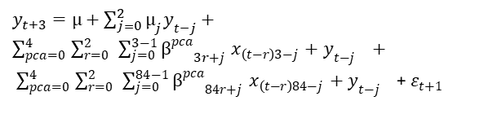
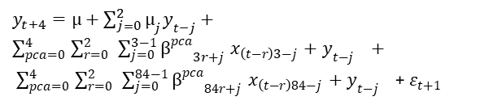
Model
3 Quarter Ahead
4 QuarterAhead

Slide 13
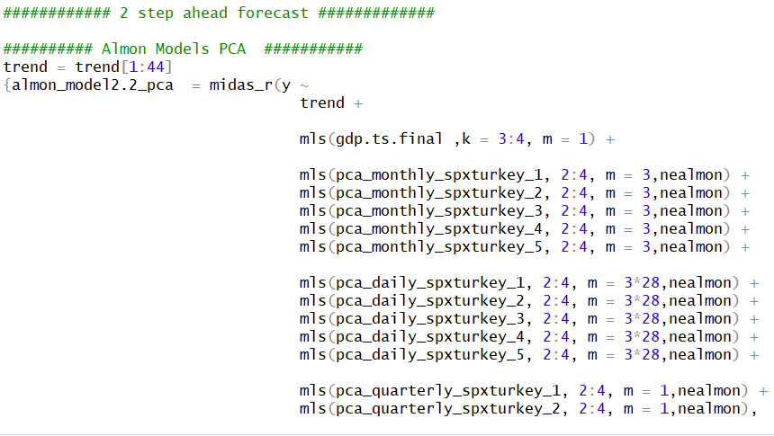
Midas Implementation
Notes:
<number>

Slide 14
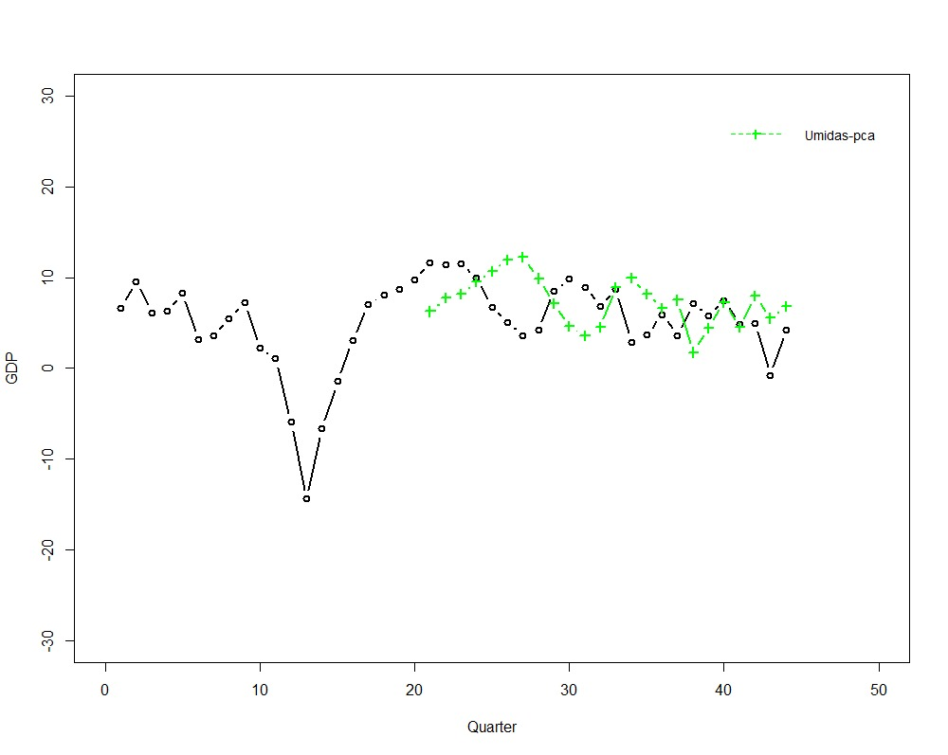
Validation
Unrestricted Model Nowcasting

Slide 15
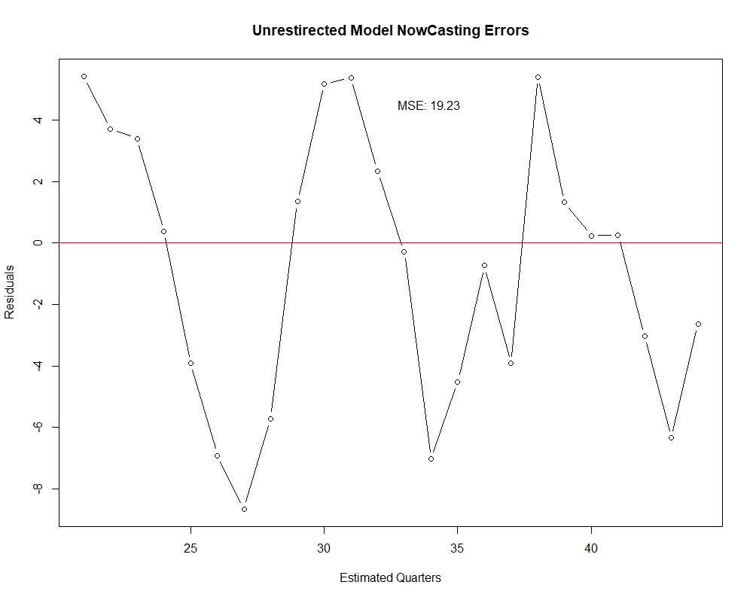
Validation

Slide 16
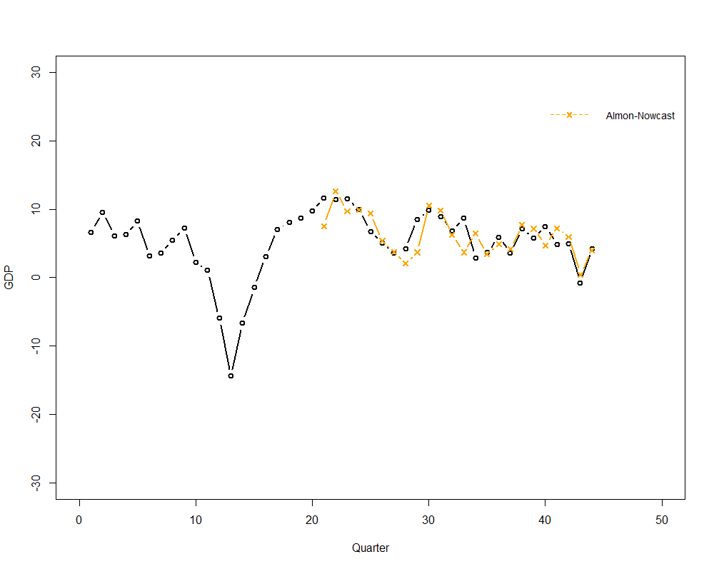
Validation
Almon Model Nowcasting

Slide 17
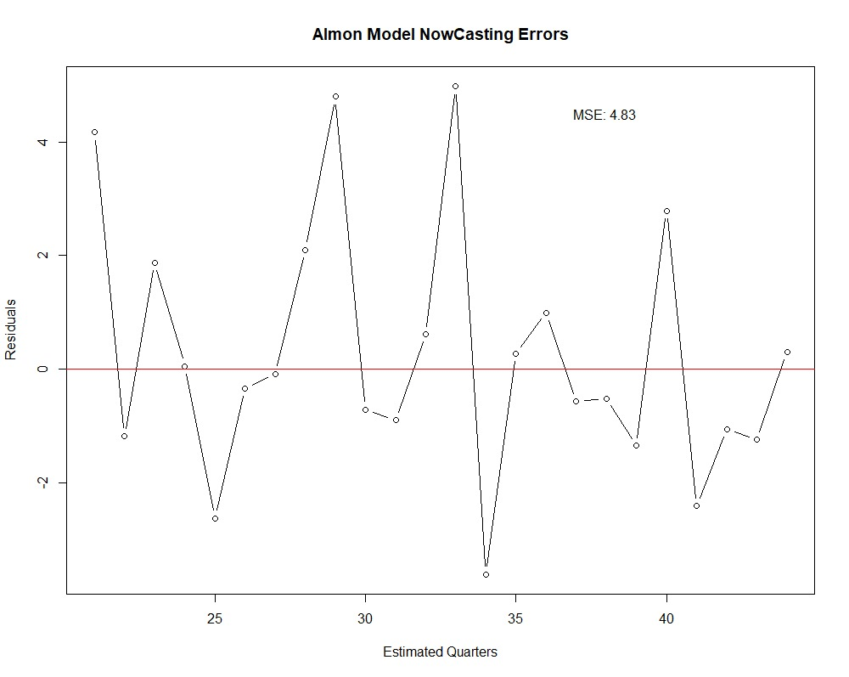
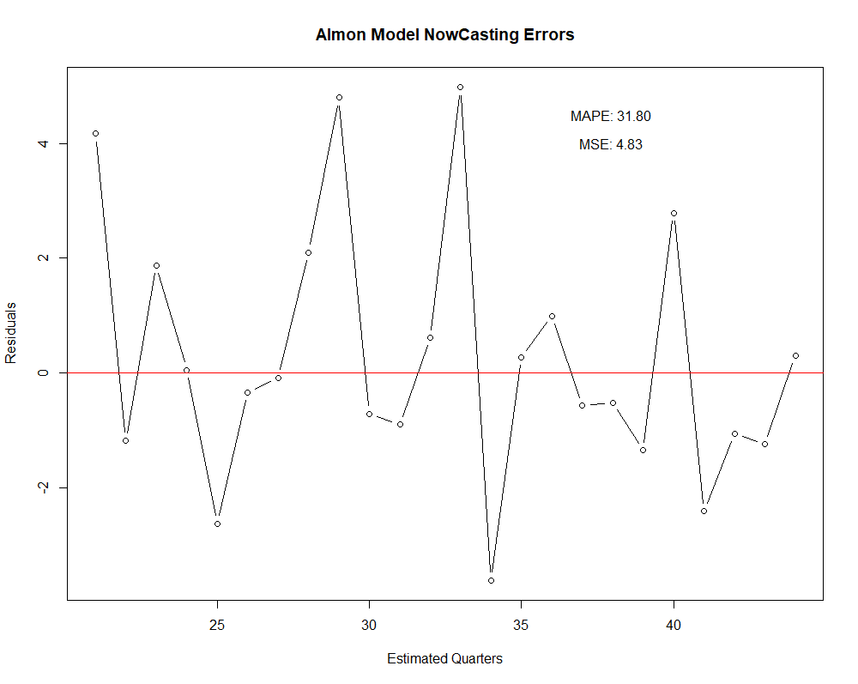
Validation

Slide 18
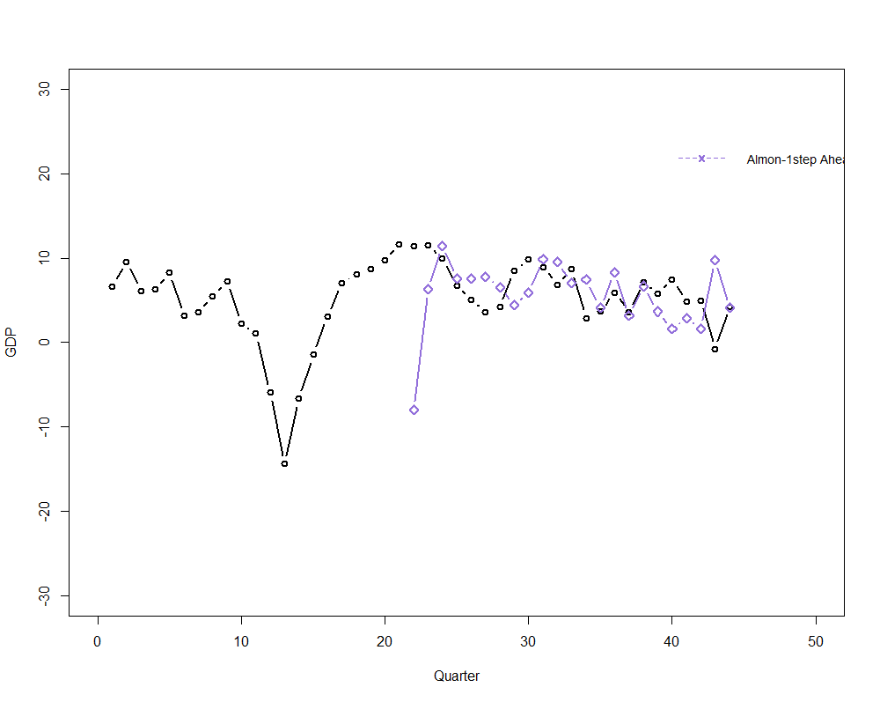
Validation
Almon Model 1 Step Ahead Forecast

Slide 19
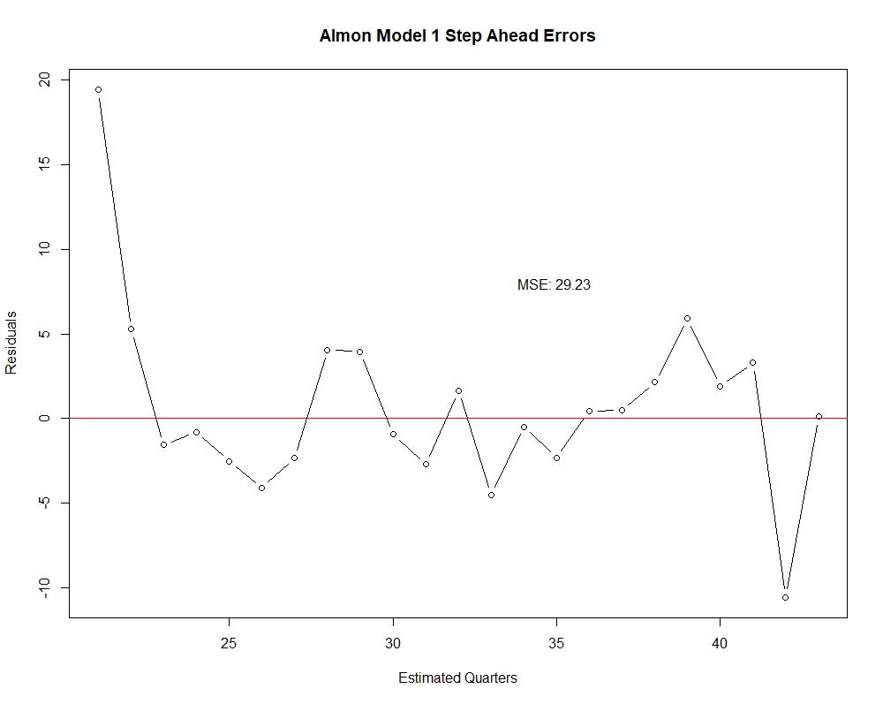
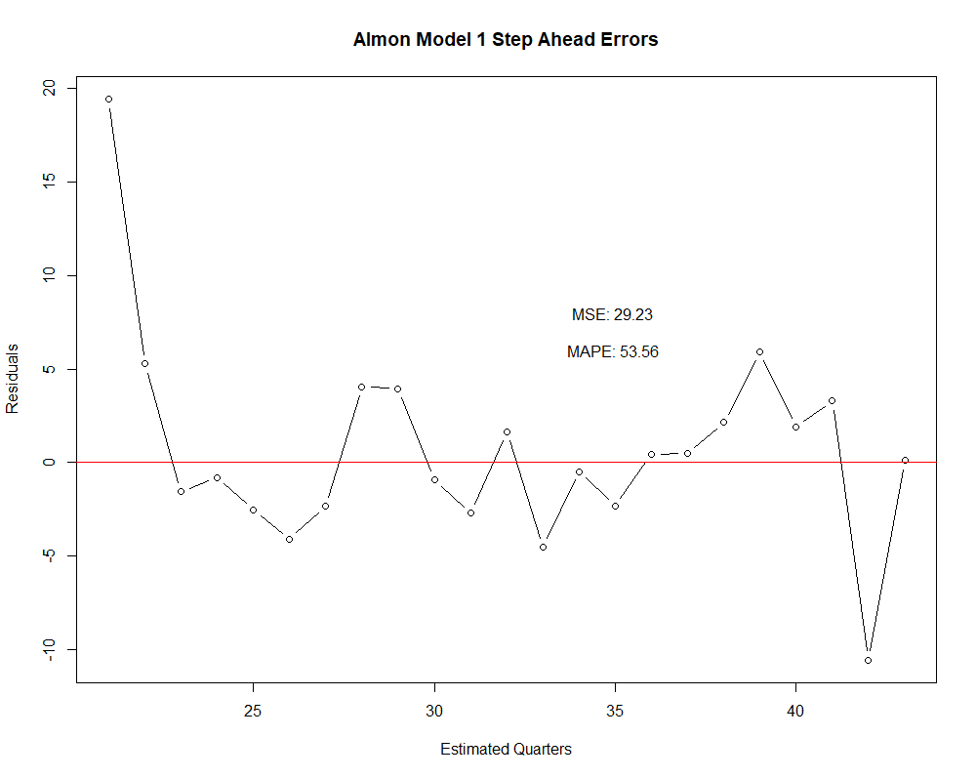
Validation
Almon Model 1 Step Ahead Errors

Slide 20
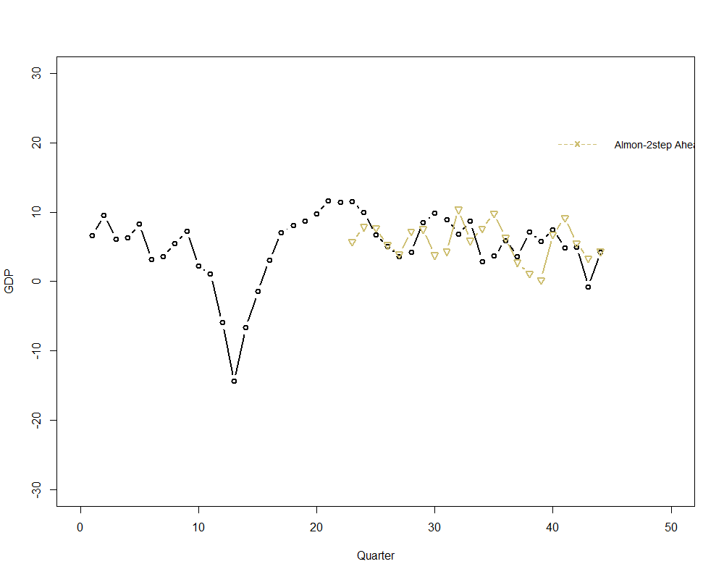
Validation
Almon Model 2 Step Ahead Forecast

Slide 21
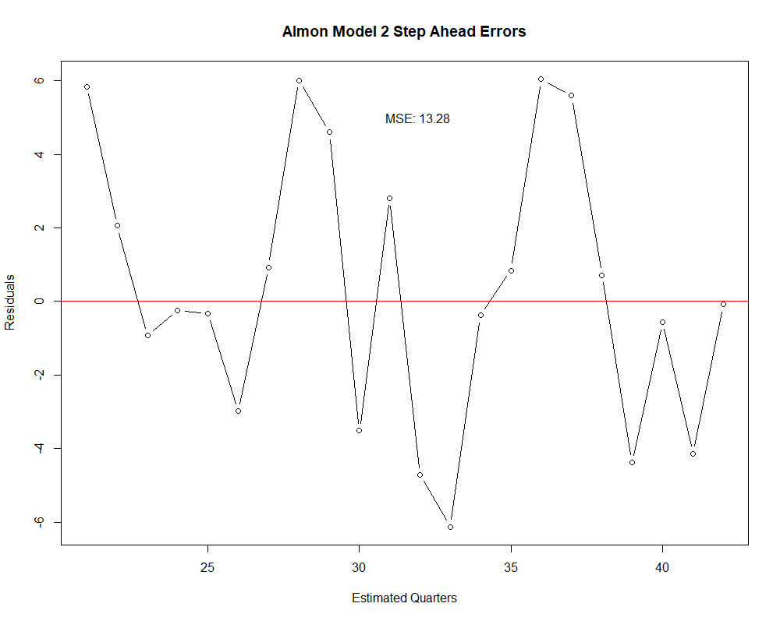
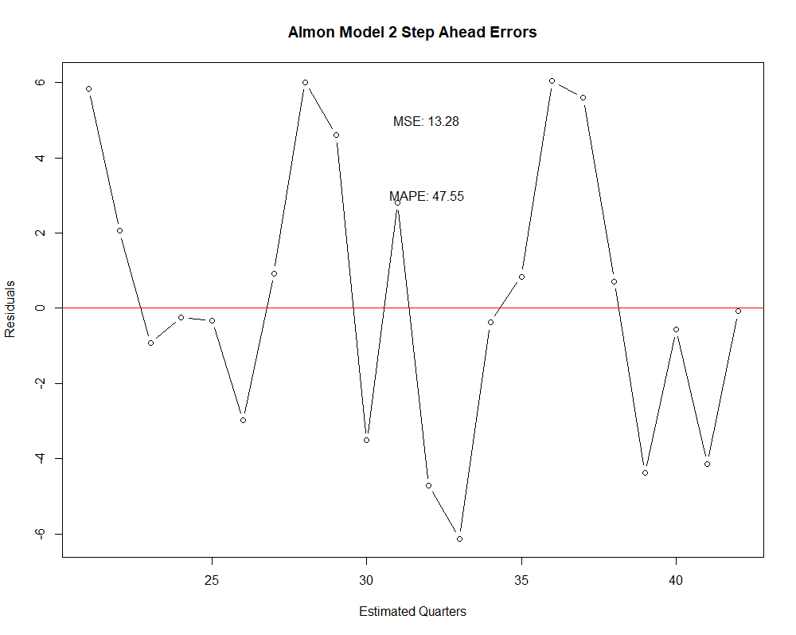
Validation
Almon Model 2 Step Ahead Errors

Slide 22
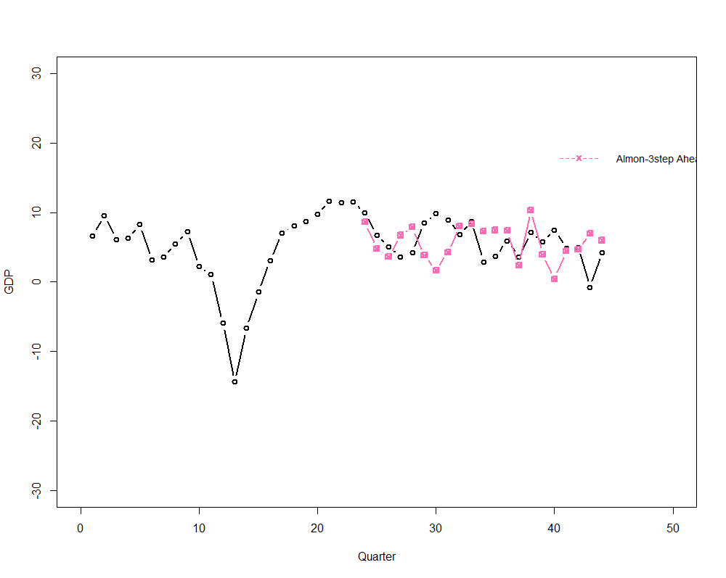
Validation
Almon Model 3 Step Ahead Forecast

Slide 23
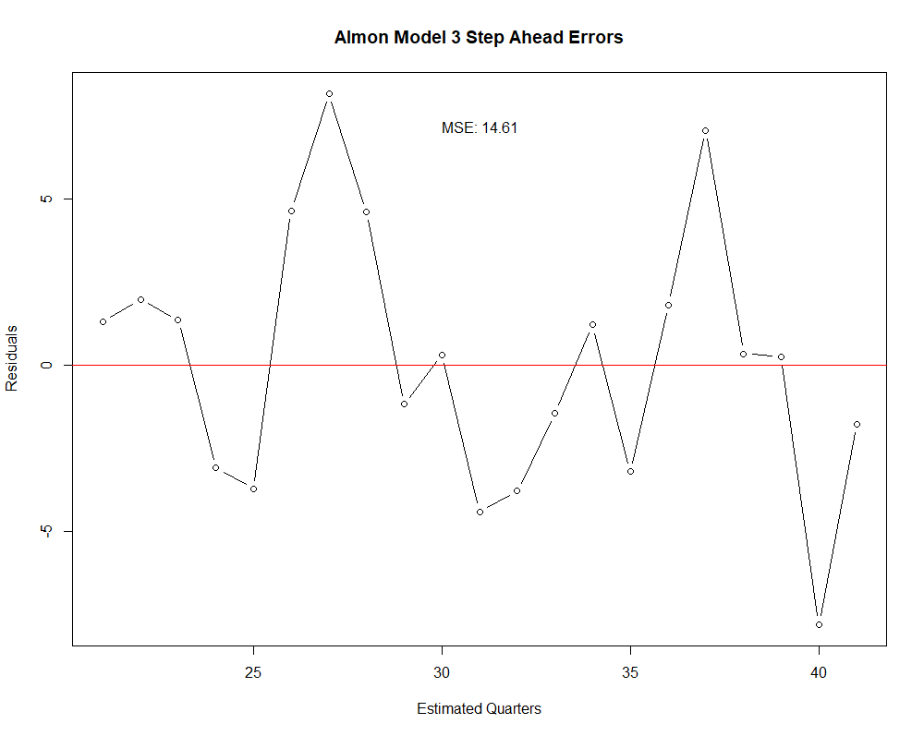
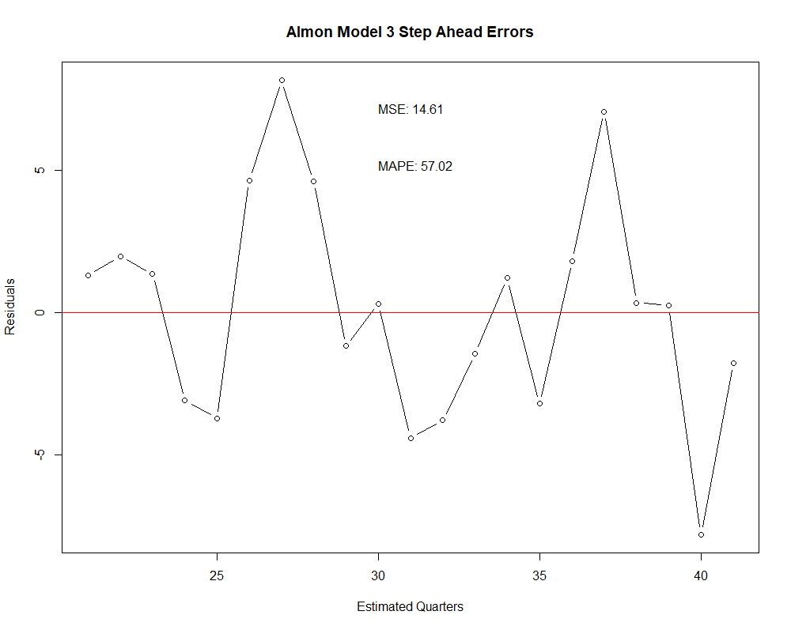
Validation

Slide 24
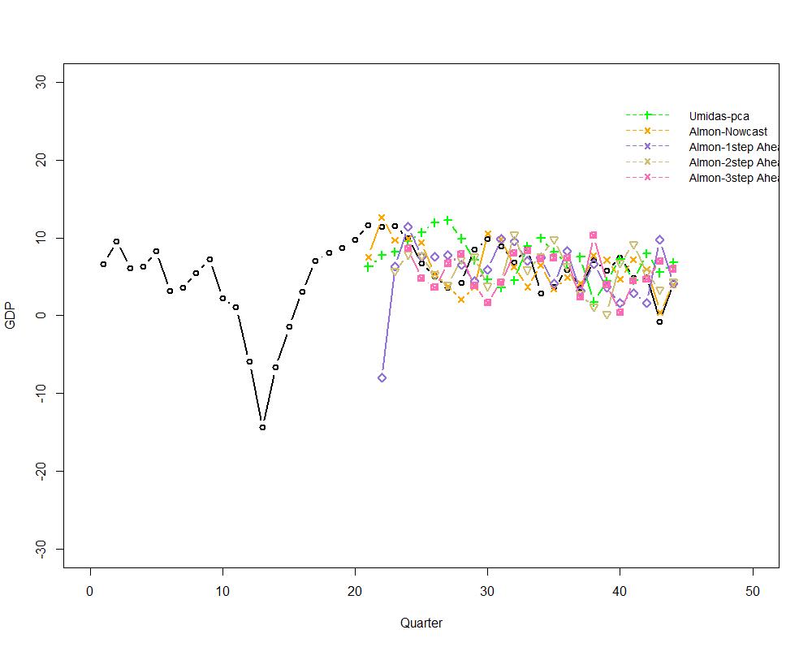
Validation
All Models Forecast

Slide 25
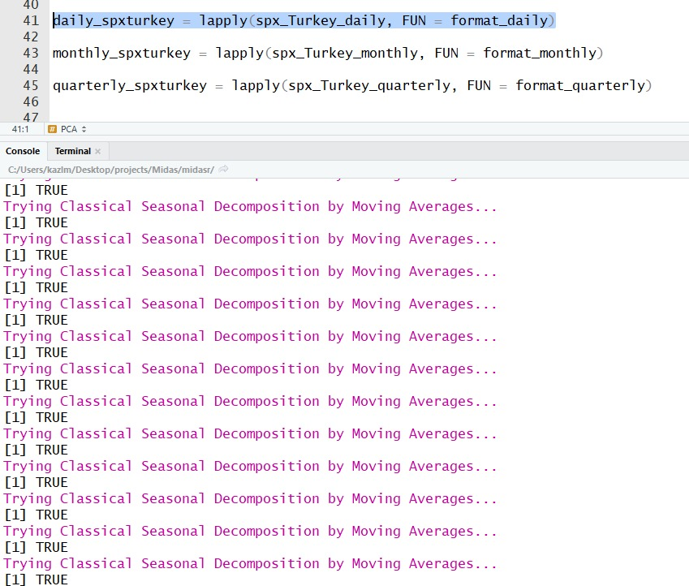
Validation

Slide 26
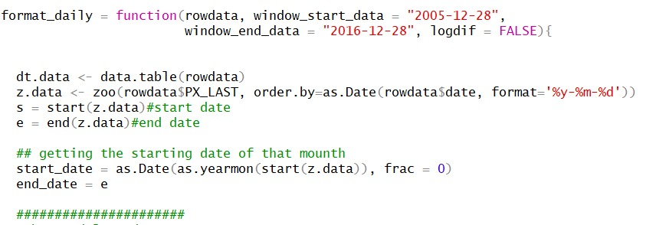
Model Flexibility
Notes:
<number>

Slide 27
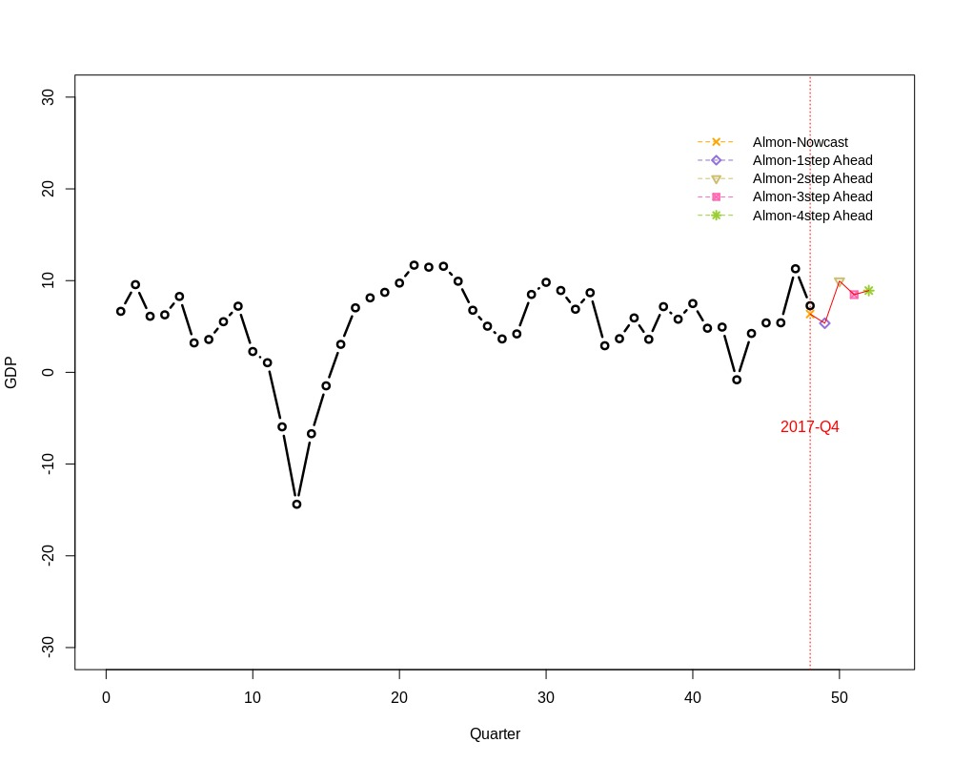
Forecasts between 2017 Q4-2018 Q4

Slide 28
Results
7.4 %
2017 Real GDP
Time Period | Forecast Value
2018, 1st Quarter | 5.350071
2018, 2nd Quarter | 9.953186
2018, 3rd Quarter | 8.467694
2018, 4th Quarter | 8.908118
6.35 %
Our Forecast

Slide 29
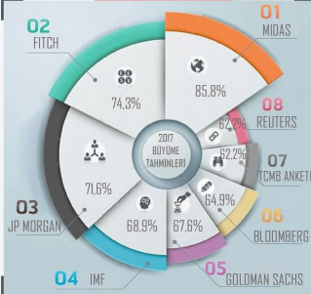
Success Rates
Success Rate: 85.8

Slide 30
References
Andreou, Elena, et al. "Should Macroeconomic Forecasters
Use Daily Financial Data and How?." Journal of Business and Economic Statistics, vol. 31, no. 2, 2013, pp. 240-251. EBSCOhost,doi:www.tandfonline.com/loi/ubes20#.UdxlRayE
U. Doğan, Midiliç, et al. “Forecasting Turkish Real GDP
Growth in a Data Rich Environment” accessed 02.11.2017
Eric, Ghysels, et al. "Mixed Frequency Data Sampling
Regression Models: The R Package Midasr." Journal of Statistical Software, Vol 72, Iss 1, Pp 1-35 (2016), no. 1, 2016, p. 1. EBSCOhost, doi:10.18637/jss.v072.i04.

